Slide 1
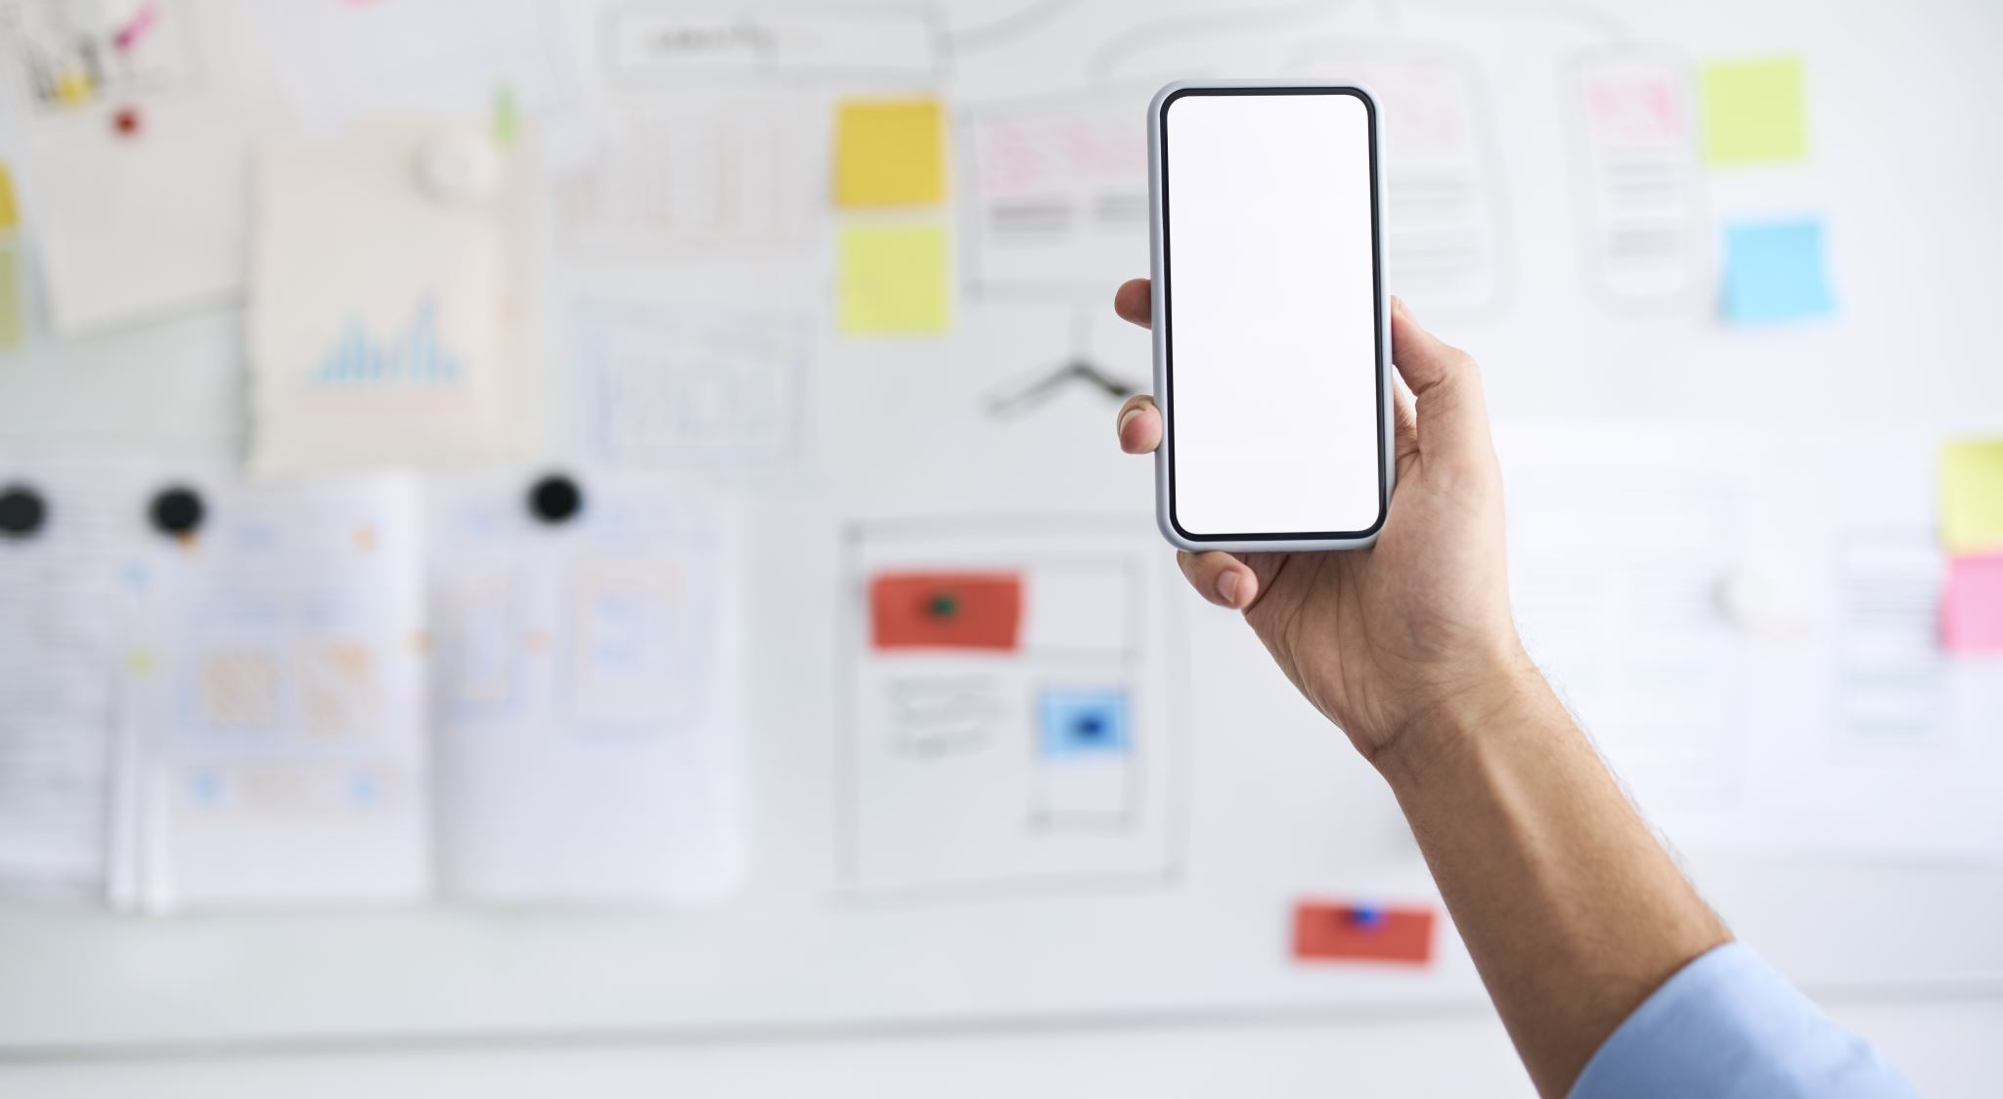
Miguel Artache – University of Arizona Global Campus
Date: October 14, 2024
Handyman Central Mobile Application
Notes:
Hello, everyone. My name is Miguel Artache, and today I’ll be presenting the Handyman Central mobile application, developed as part of my project at the University of Arizona Global Campus.
This app is designed to bring DIY enthusiasts together on one platform for information sharing, skill-building, and community engagement.

Slide 2
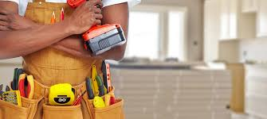
Definition Statement
Handyman Central aims to centralize all “Do It Yourself” individuals to a social media platform to share information, explore articles, and engage in rich video content. Through collaboration, this application aims to increase self-sufficiency and increase skills.
Notes:
Handyman Central is envisioned as a social media platform specifically for DIY enthusiasts. Our mission is to centralize resources, provide engaging video content, and allow users to share their own experiences and insights.
By fostering collaboration and knowledge-sharing, we aim to empower users with increased self-sufficiency and practical skills.

Slide 3
Application Overview
The application is built on Apple IOS and is compatible with Apple iPhones and iPads.
The main layout of the UI is articles, Live Blogs, and Video Content.
The main content categories include electrical, plumbing, carpentry, painting, and masonry.
Leverages touch gestures and clean UI leveraging earth tone color hues.
Video content is available for premium subscribers.
Notes:
Here, I’ll provide a brief overview of the application, including its main functionalities and layout. The platform is designed to be intuitive and accessible, supporting users at all skill levels to access information and connect with others.

Slide 4
Key Features
Rich Video Content for premium subscription account holders
Clean User Interface for easily navigation
Reuse several data fragments to allow for seamless usability of multiple screen sizes
In-Screen and pop up video play for easy viewing.
Dynamic article content and live video feed for instant feedback on challenges and home projects
Notes:
The key features of Handyman Central include an organized content structure with articles, blog posts, and video tutorials.
Users can explore DIY projects based on their interests, with relevant content easily accessible to keep engagement high.

Slide 5
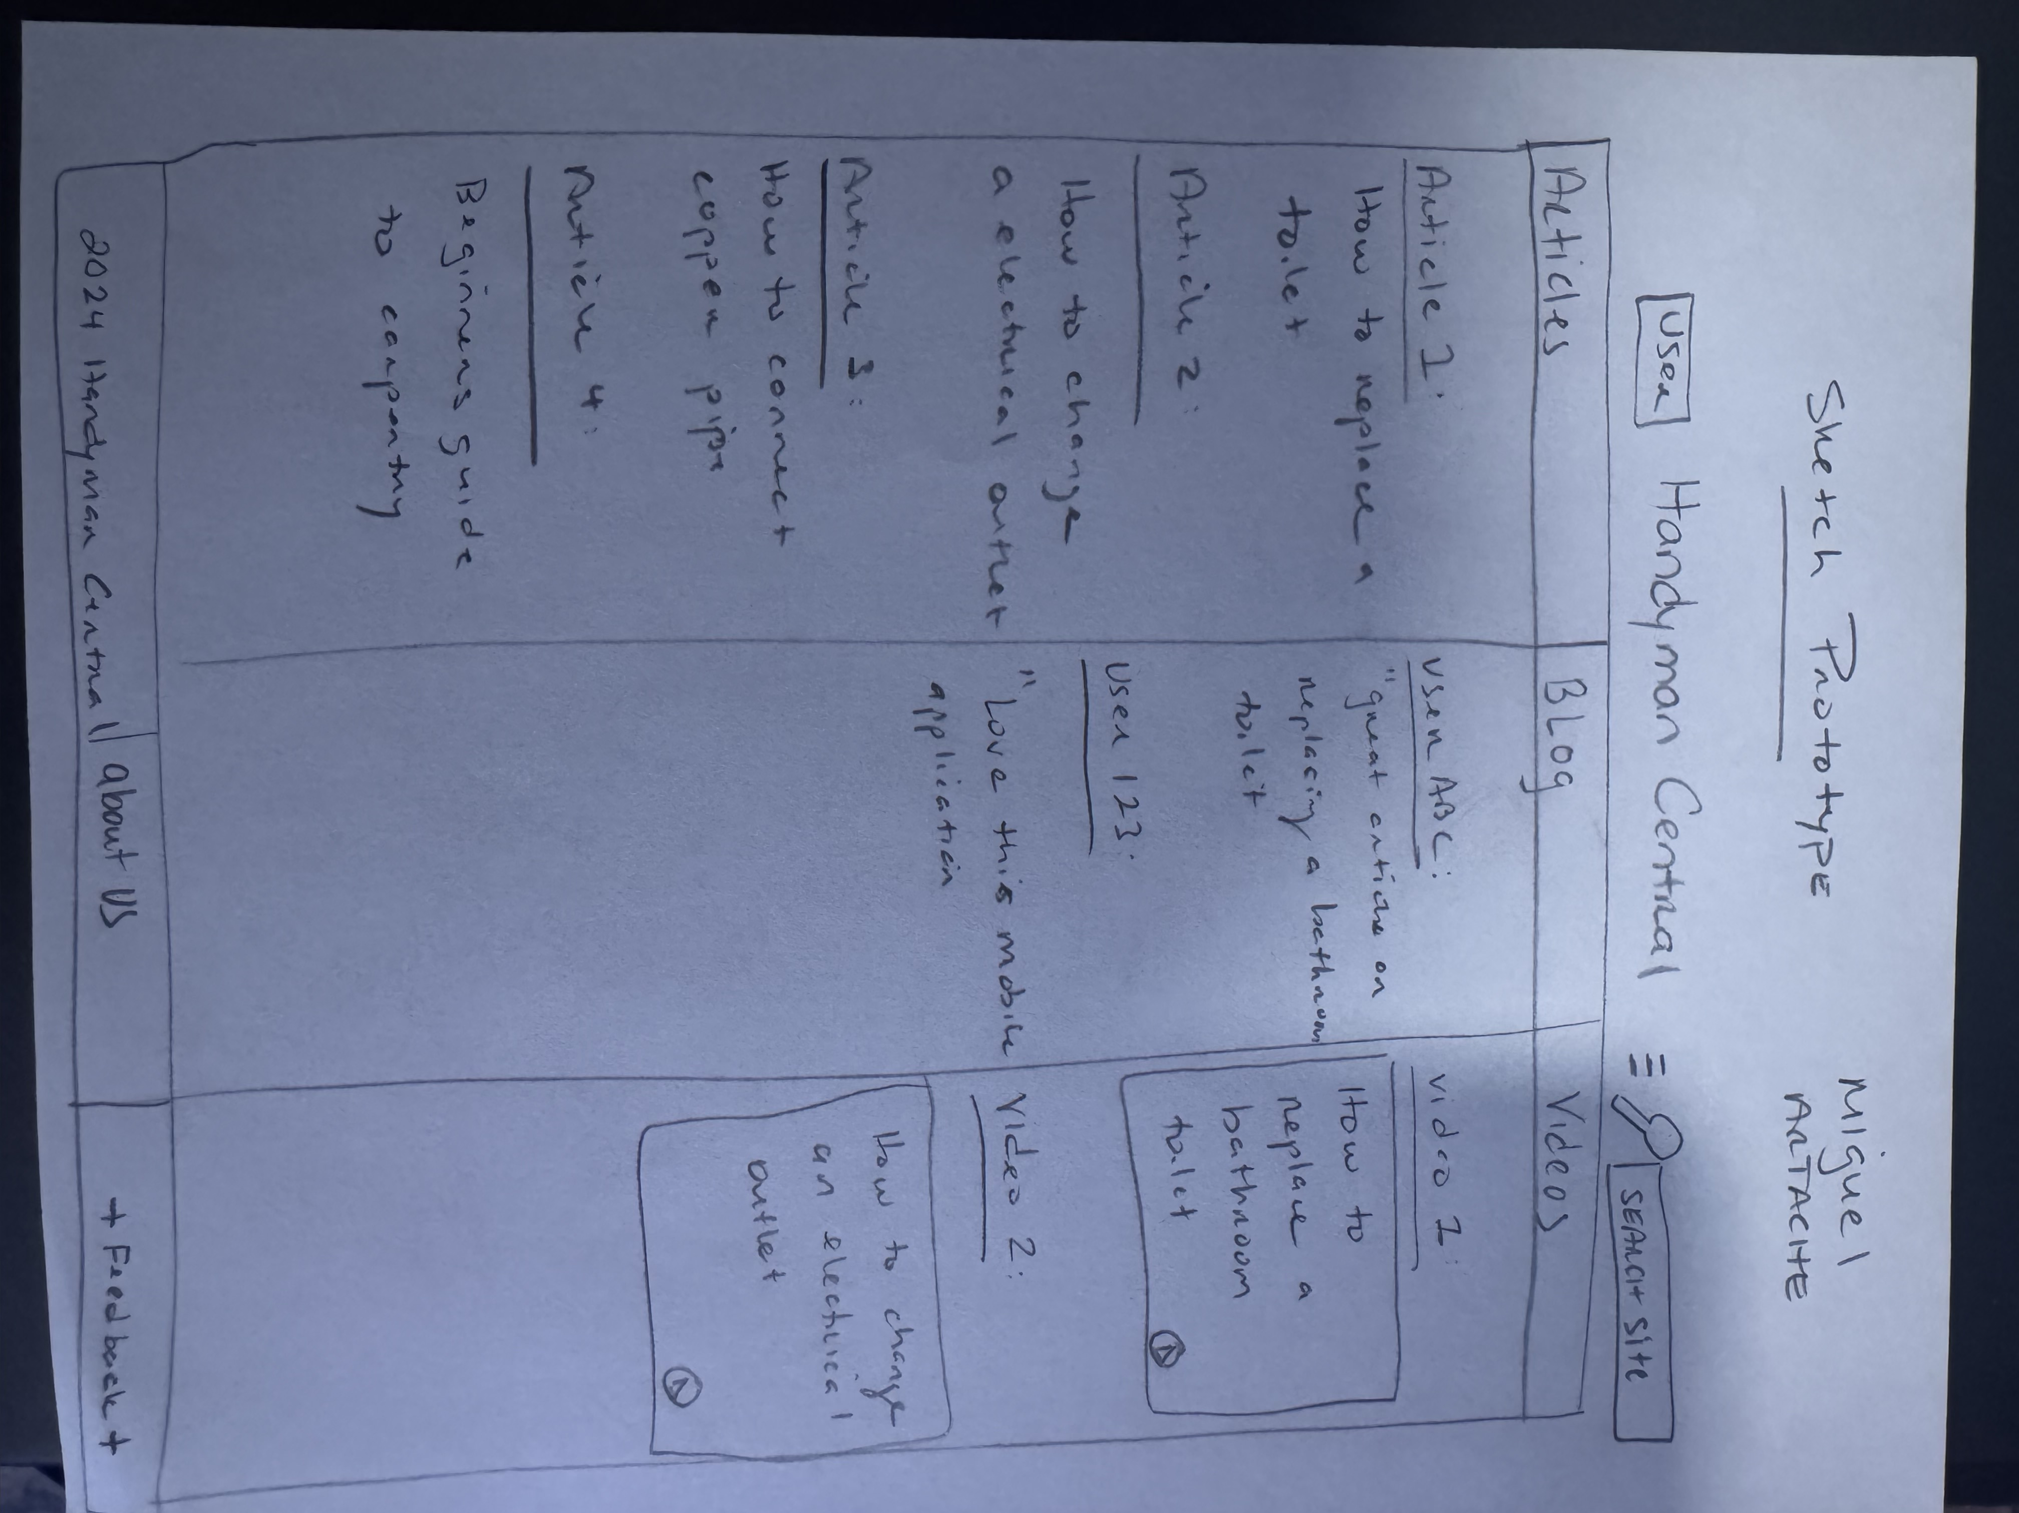
Initial Paper Sketch
This low fidelity sketch was used to determine alignment with project sponsors and stakeholders.
This sketch shows the framework of what the application will look like.
Notes:
This slide shows our initial paper sketch. Early sketches like these help establish the app's framework, providing a visual layout to align project goals with the expectations of sponsors and stakeholders.

Slide 6
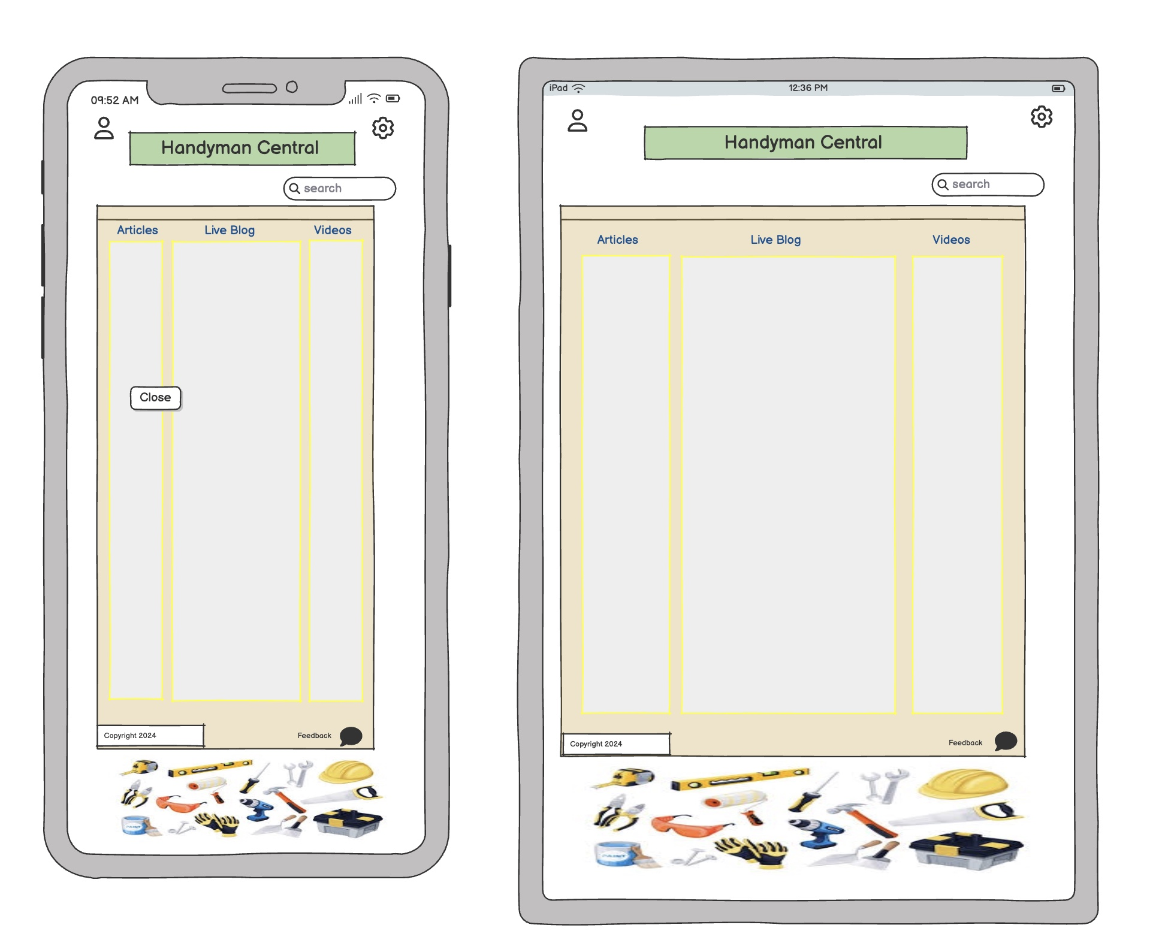
Application Mock-up
A high-fidelity sketch was used to provide a real-life view of the final application view.
Notes:
Once we finalized the layout with our stakeholders, we moved to a high-fidelity sketch. This mock-up offers a more realistic representation of the final app design, giving everyone a clearer picture of the user interface.

Slide 7
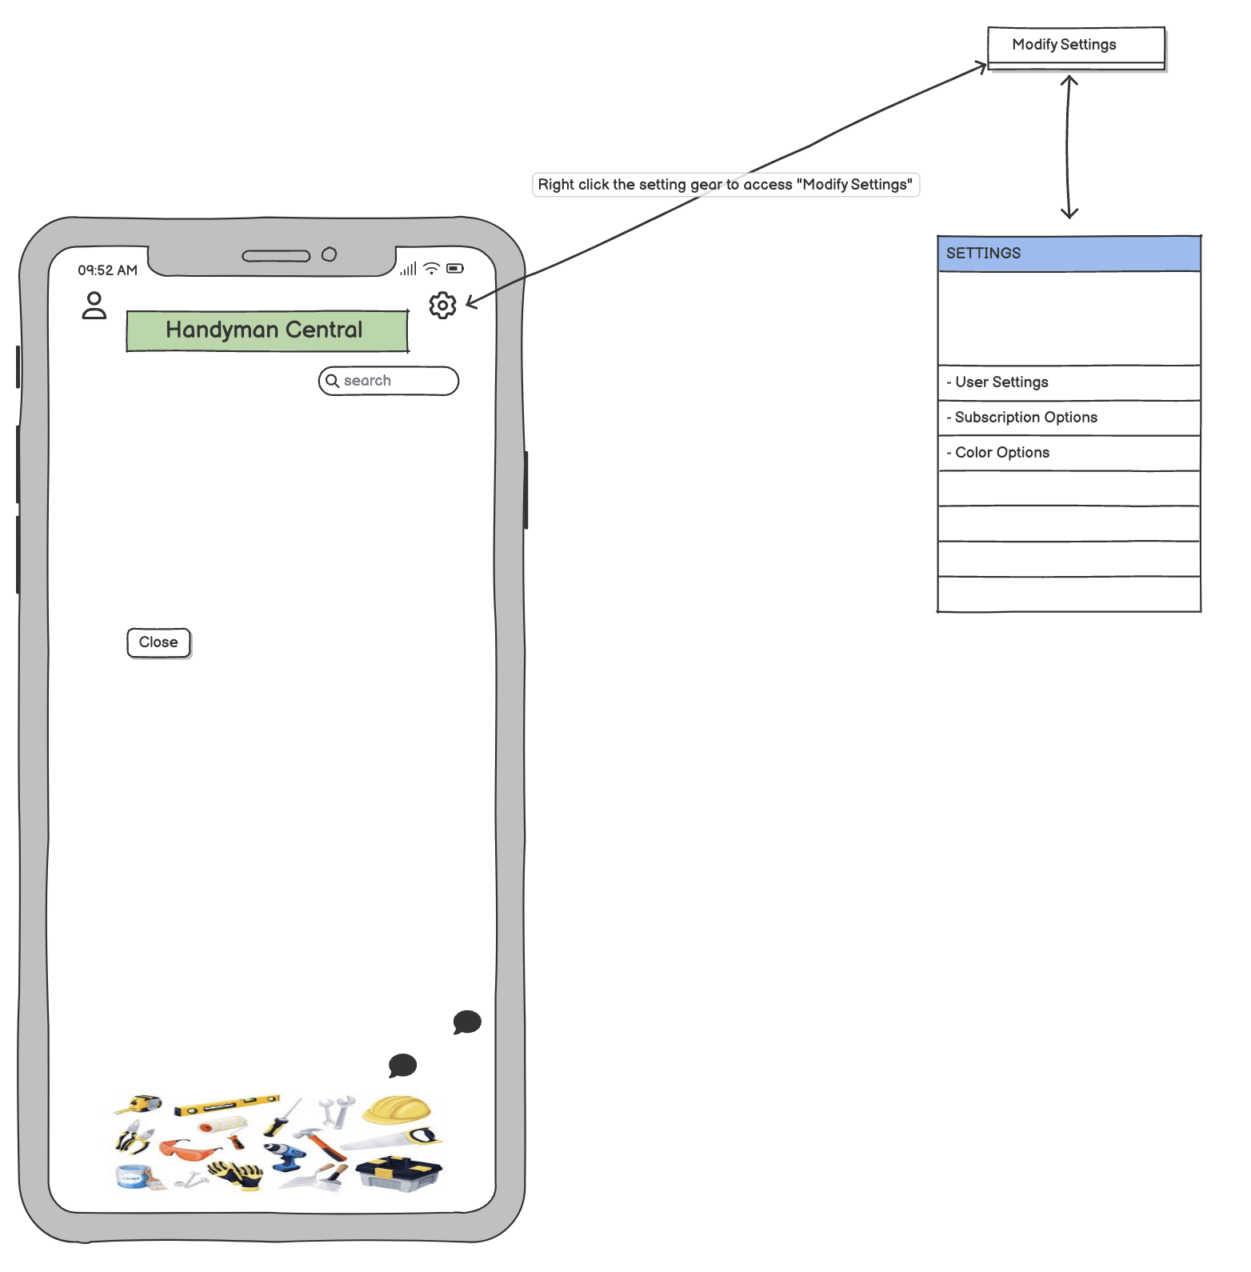
User Settings
Upon clicking on the gear, the user can modify settings such as colors, subscription and general user settings
Notes:
The User Settings menu is accessed by clicking on the gear icon. Here, users can customize app settings, adjust colors, manage subscriptions, and update general preferences to personalize their experience.

Slide 8
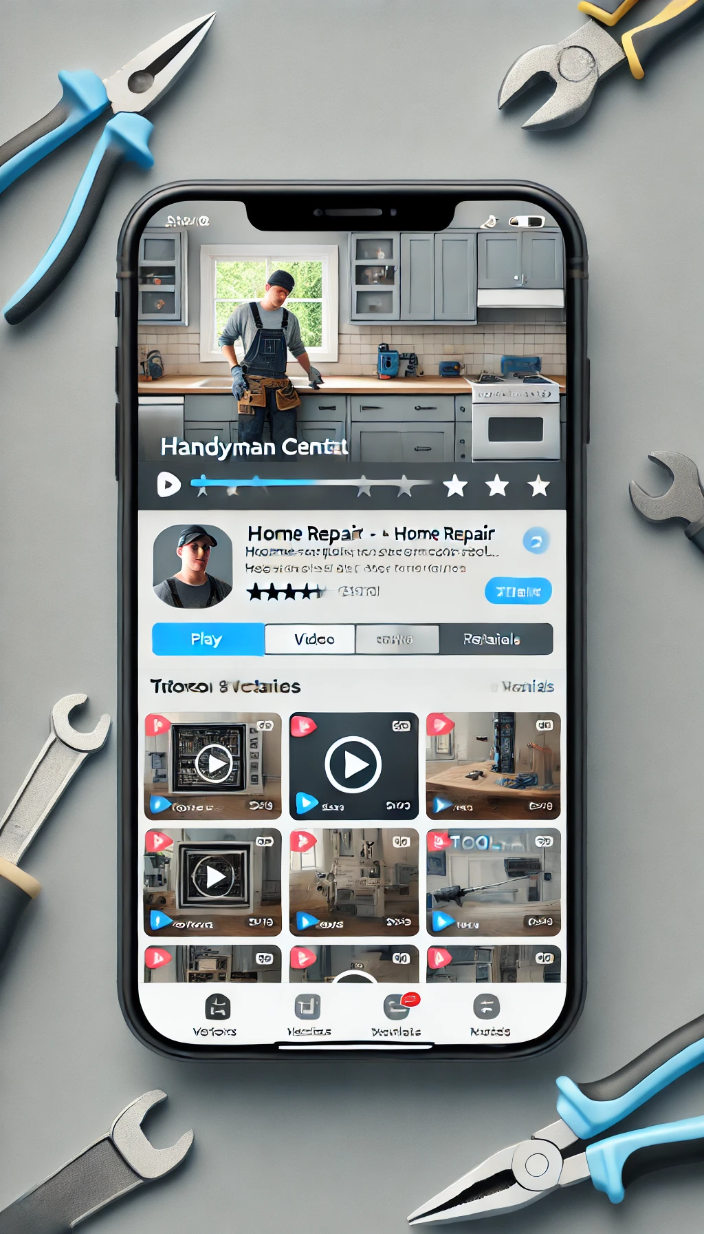
Video Content
Video content is available to all premium subscribers for all DIY projects.
Subscription content is $9.99 per month.
Notes:
One of our premium features is the extensive video content library, accessible for $9.99 per month. These videos cover a wide range of DIY projects and are exclusive to premium subscribers, adding value for users who want comprehensive tutorials.

Slide 9
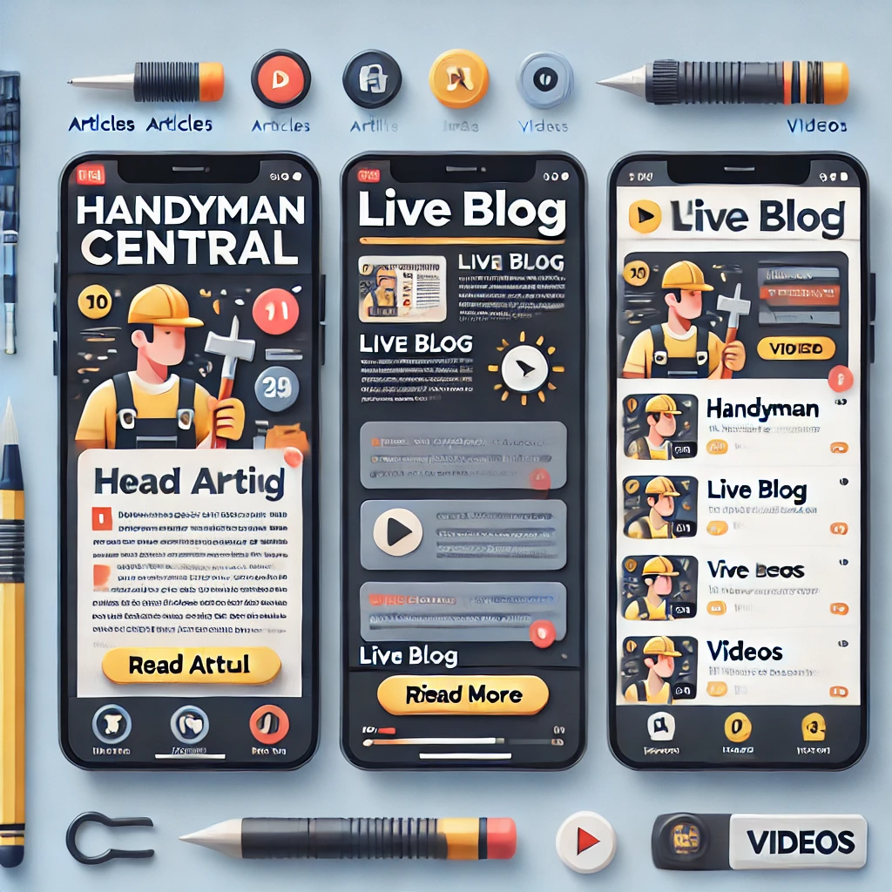
Application Final Product Mock-up
Each section is broken down by articles, blog, and video.
The user can quickly navigate between each element to quickly access the content that they are seeking.
Based on AI logic, content will be presented on the interests of the user.
Notes:
This mock-up highlights the final product design. We’ve organized content by sections – articles, blogs, and videos – so users can quickly navigate to what they’re looking for. AI-based recommendations will personalize the experience for each user, based on their activity and interests.

Slide 10
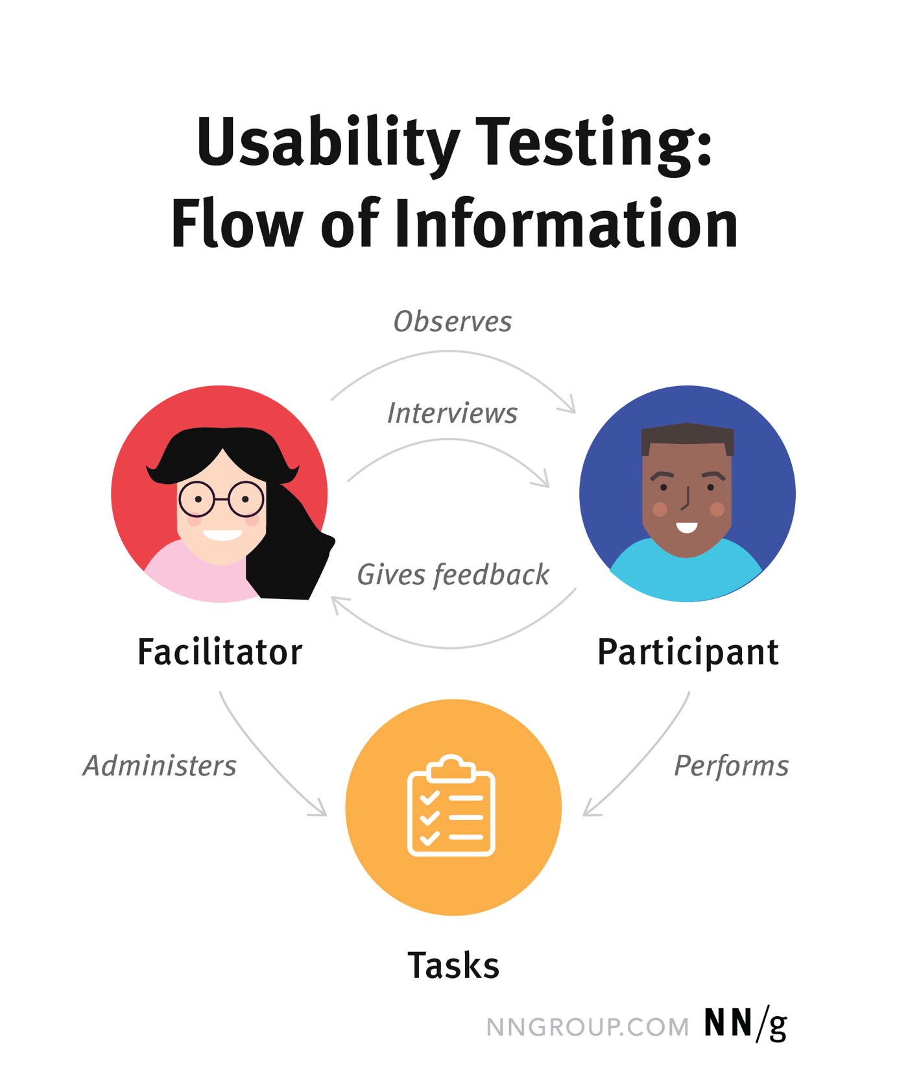
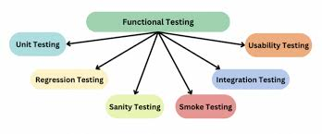
User Testing
We performed several tests with end users test group that included functional, usability, and performance test.
Each testing sprint provided outputs on improvement to the final product before delivering to production.
We collect further enhancements that were outside the scope of the development effort that will be developed and delivered.
Notes:
We conducted rigorous testing with a select group of end users, focusing on functionality, usability, and performance. Each testing sprint helped refine the app further, and we documented feature requests outside of the initial scope for future development.

Slide 11
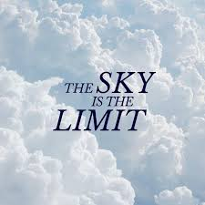
Next Steps and Conclusion
Handyman Central is a next generation application that will bring the “Do it Yourself” people worldwide to one place to collobrate, empower, and build self-confidence to take on hand job around your home
Notes:
In conclusion, Handyman Central is a pioneering app for DIY communities worldwide. Our platform will enable users to collaborate, build confidence, and take on home improvement projects independently.
Next steps include incorporating user feedback, refining features, and expanding our community reach. Thank you for your attention.

Slide 12
